Slide 1

Photosynthetic Adaptations of Polar Phytoplankton to Extreme Low Light
Natasha Madeleine Ryan
Supervised By Dr. Douglas A. Campbell

Slide 2
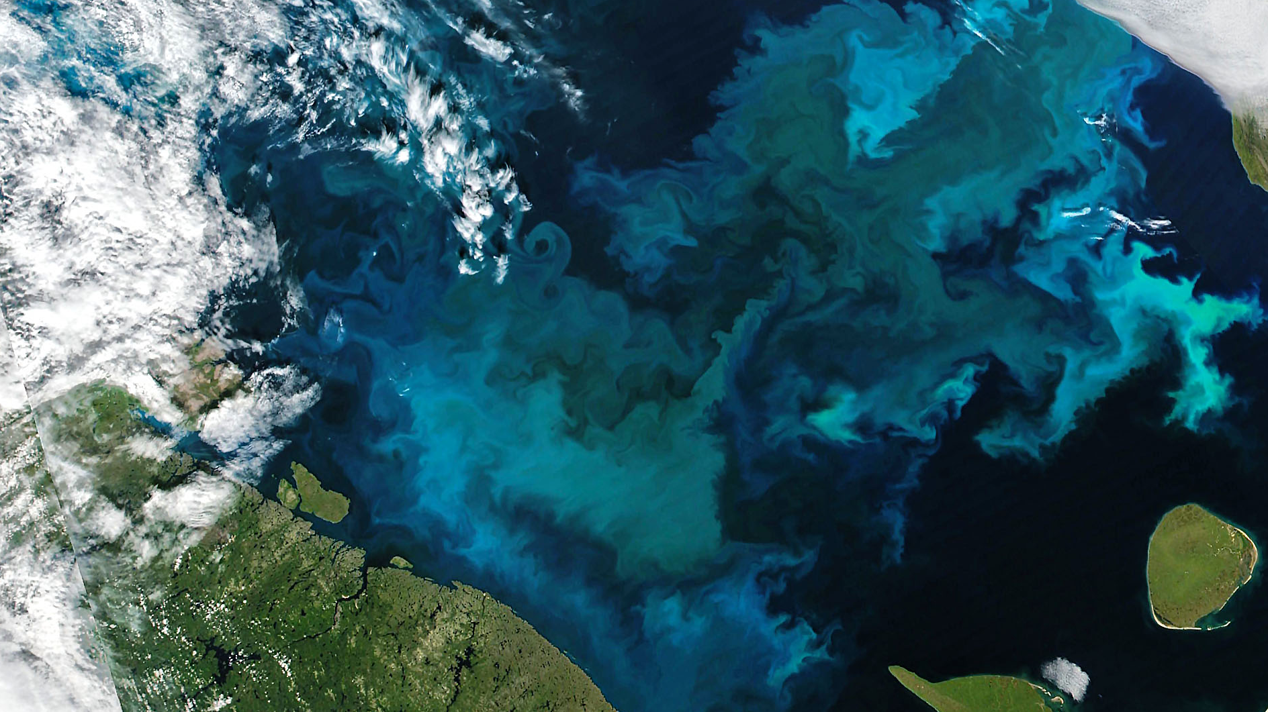
Phytoplankton Bloom in the Barents Sea, August 2021. Image: Joshua Stevens (NASA)

Slide 3

Photic Constraints
Light Attenuation
Solar Angle

Slide 4
Have polar phytoplankton adapted to extremely low light by increasing their efficiency of photosynthetic energy conversion?

Slide 5
Have polar phytoplankton adapted to extremely low light by increasing their efficiency of photosynthetic energy conversion?
hypothesized mechanism: suppressing energetically wasteful charge recombinations in Photosystem II

Slide 6
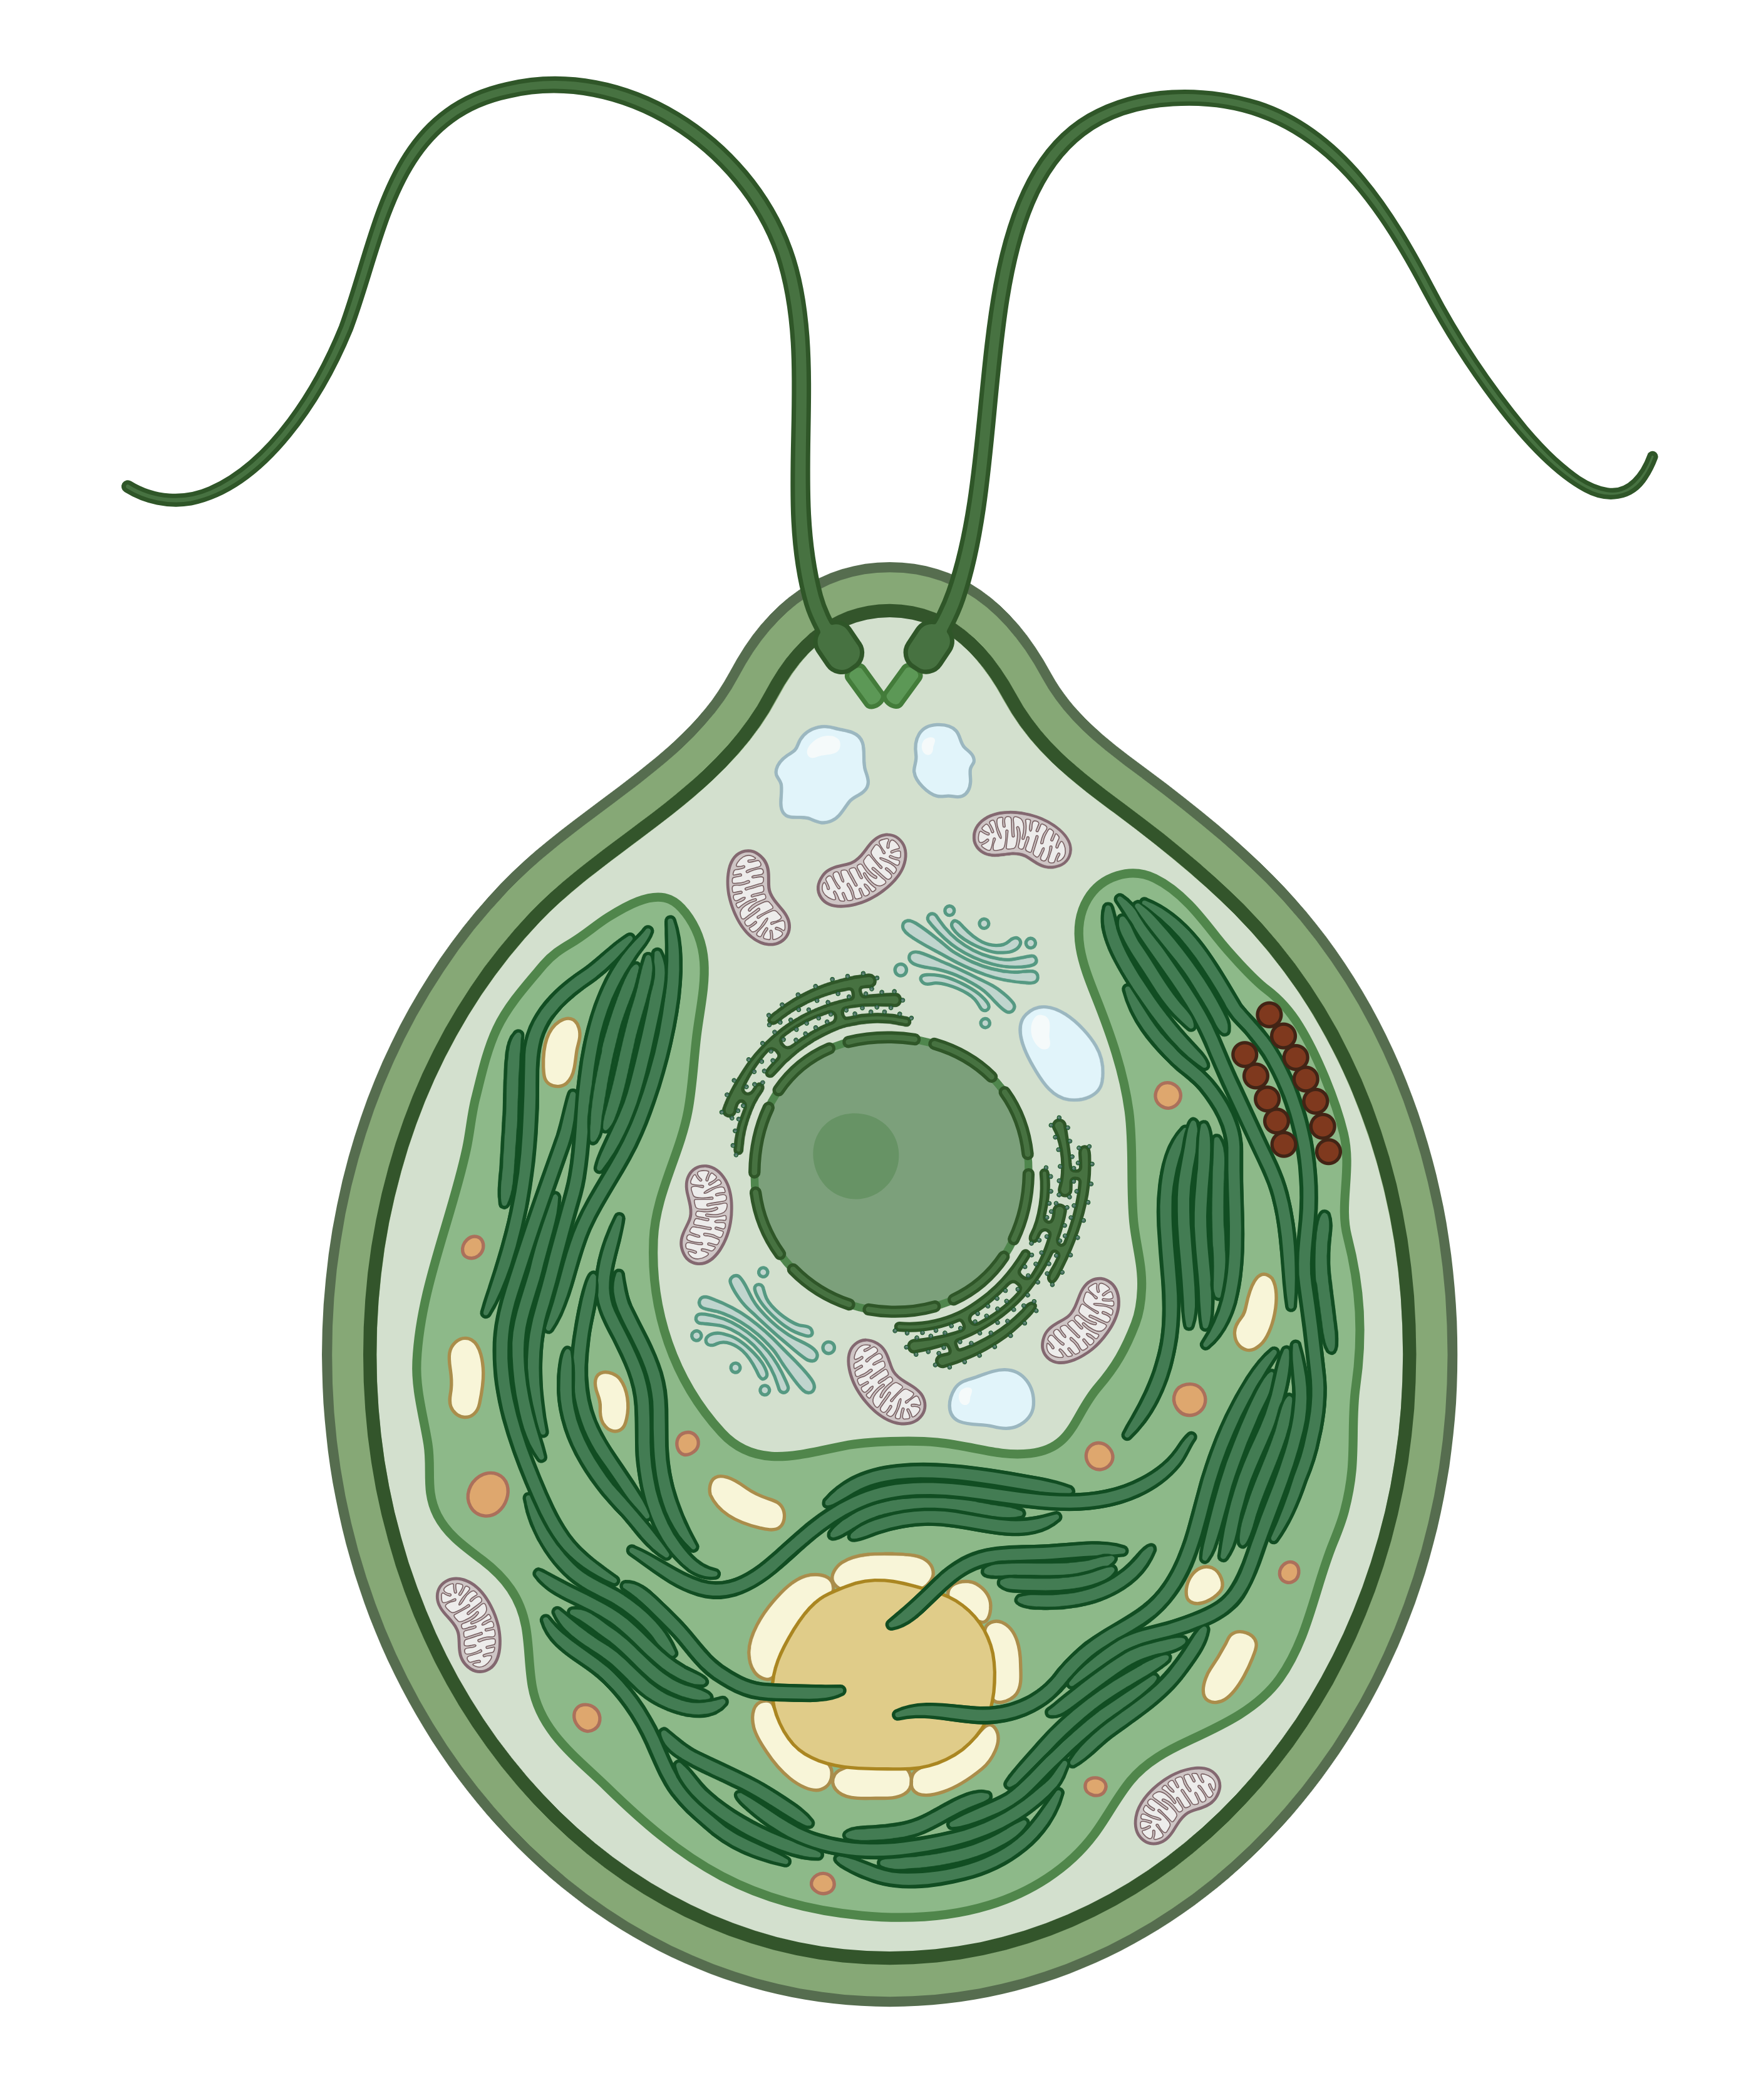
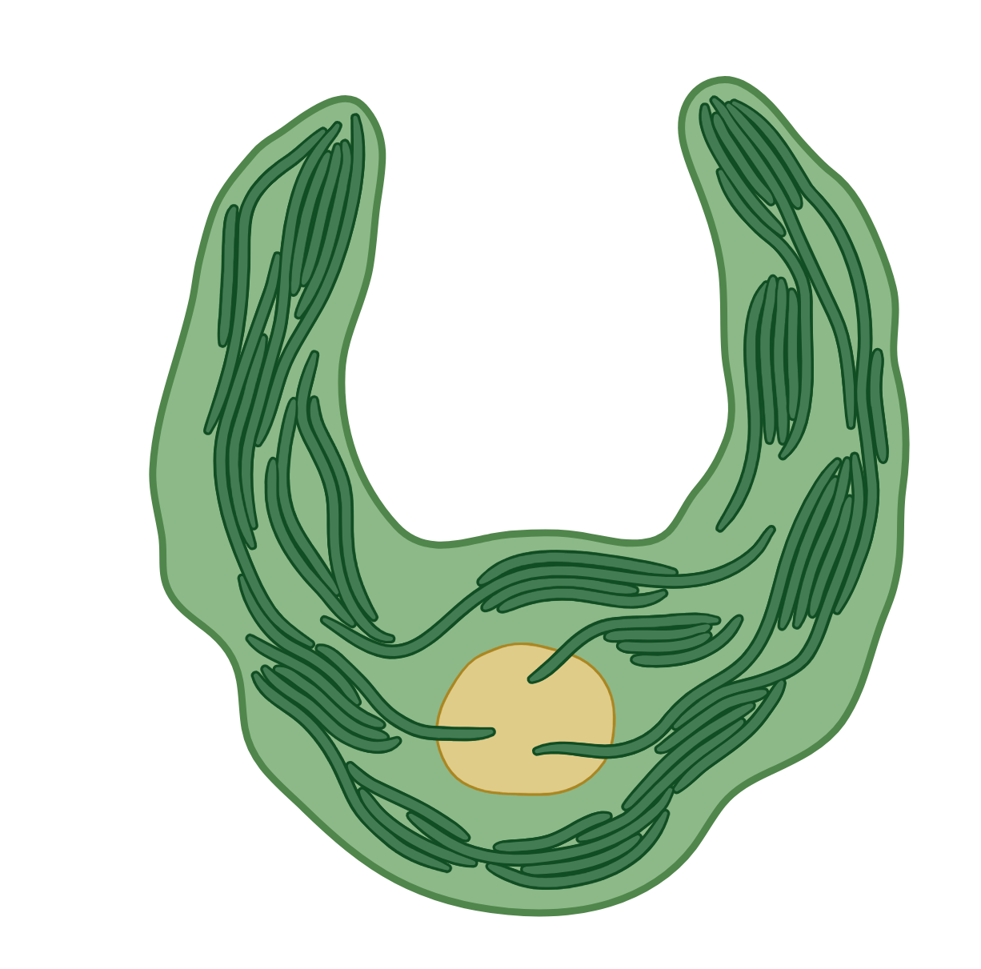
Phytoplankton Cell

Slide 7
Chloroplast

Slide 8

Thylakoid

Slide 9







Q_{A}
Q_{B}
Phe
P₆₈₀
Y_{Z}
OEC
Photosystem II

Slide 10
S-State Cycle
P₆₈₀⁺
Path of e⁻
Phe
Q_{A}
ChlF
Q_{B}
Oxygen-evolving complex
Y_{Z}
S₁
e⁻
e⁻
1
S₀
S₂
Photosystem II
O₂
Mn₄CaO₅
2
P₆₈₀
e⁻
e⁻
3
[S₄]
S₃
4

Slide 11
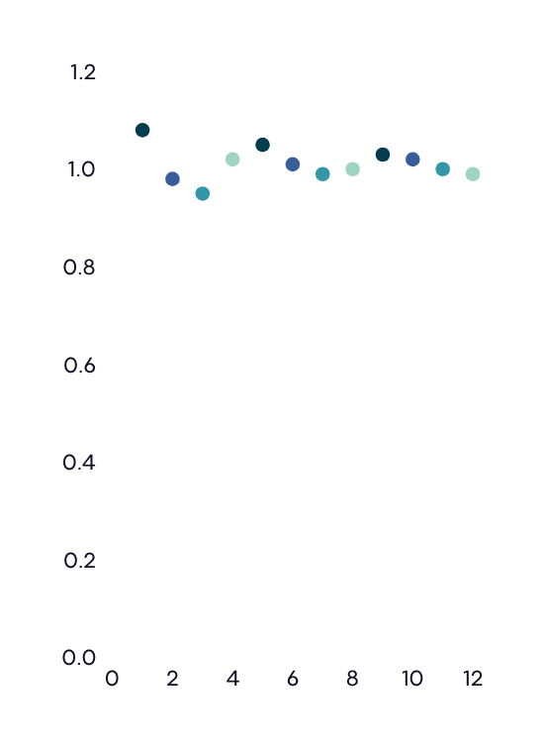





StChlF Approach
Oxygen-evolving complex
e⁻
S₁
e⁻
S₀
S₂
O₂
Mn₄CaO₅
Chlorophyll Fluorescence
e⁻
e⁻
[S₄]
S₃
1
4
2
3
Flash Number
apply sequential flashes
drive s-state cycle
monitor ChlF

Slide 12
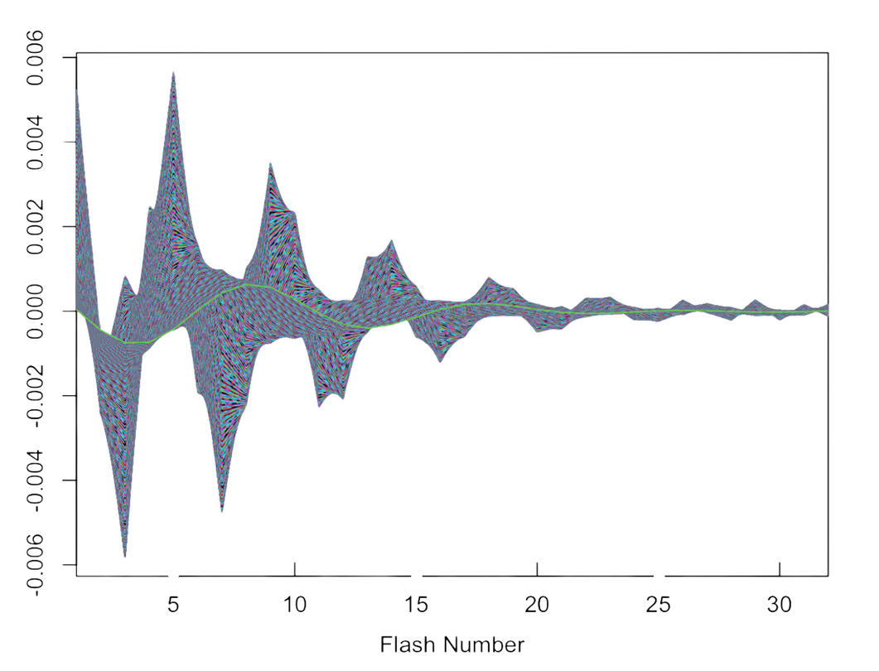
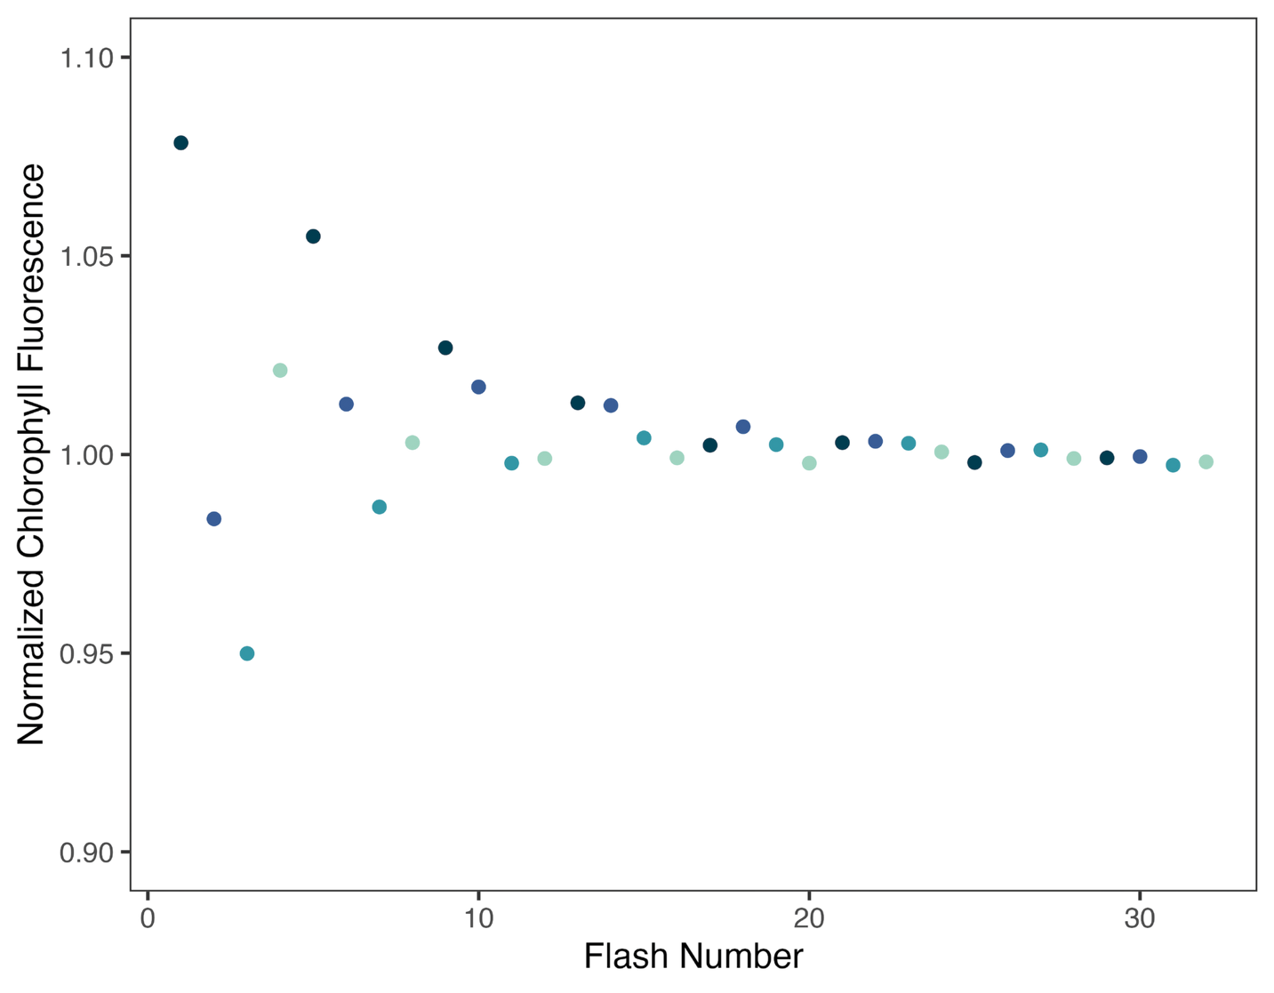
Wavelet Transformation
Sample Plots: Fragilariopsis cylindrus at 0°C and 1 second flash intervals
Raw Fluorescence Data
Fourier Wavelets
0.006
1.10
0.004
1.05
0.002
Normalized ChlF
0.000
1.00
-0.002
0.95
-0.004
0.90
-0.006
0
10
20
30
10
20
30
Flash Number
Flash Number

Slide 13
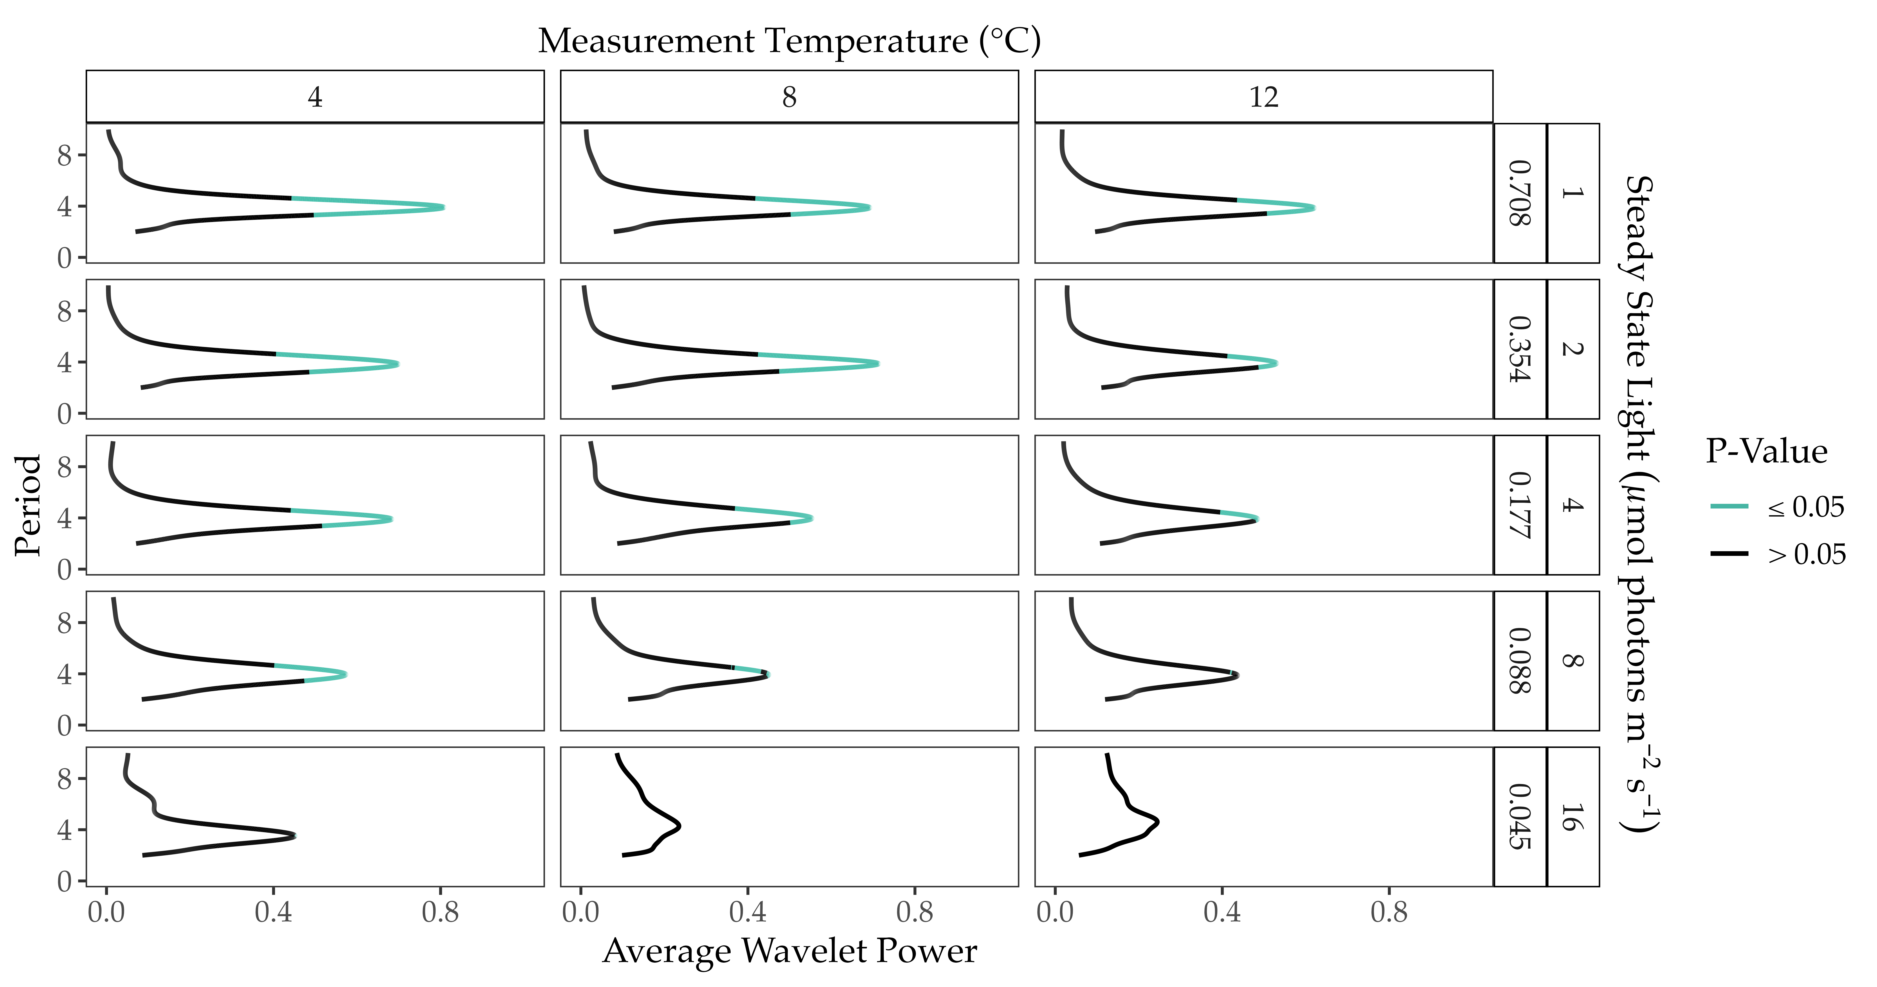
ChlF Periodicity
Sample Plot: Chlamydomonas priscuii

Slide 14
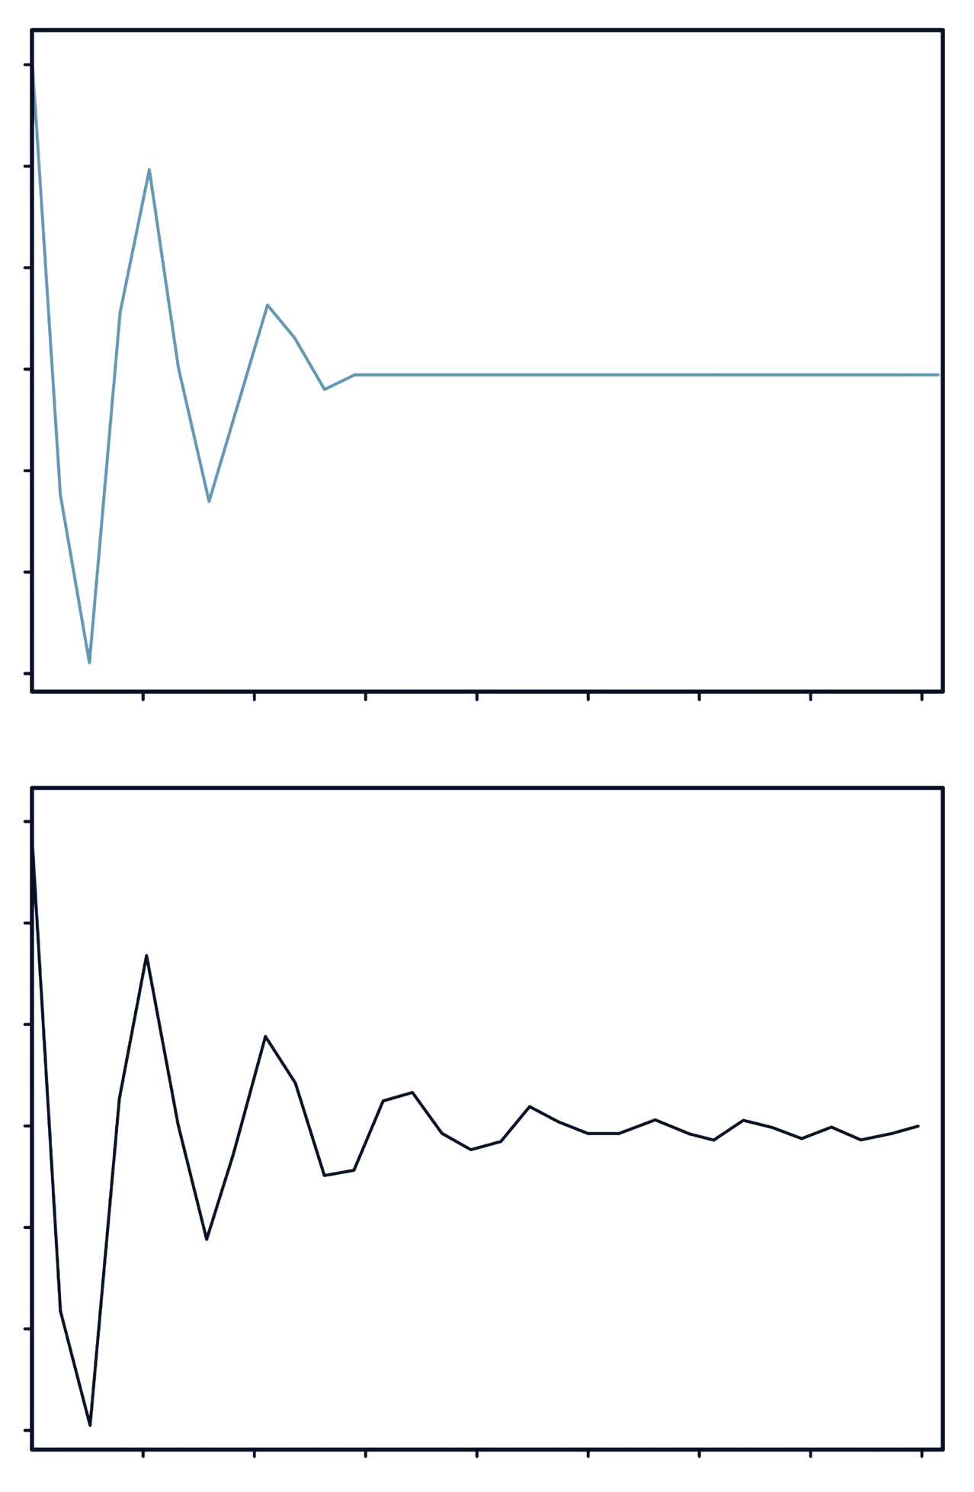
Duration of Oscillations
Original Fourier Wavelet
Reconstruction at 𝛼 =0.05
0.06
0.06
0.04
0.04
0.02
0.02
Scaled Fluorescence
0.00
0.00
-0.02
-0.02
-0.04
-0.04
-0.06
-0.06
4
8
12
16
20
24
28
32
4
8
12
16
20
24
28
32
Flash Number
Flash Number

Slide 15
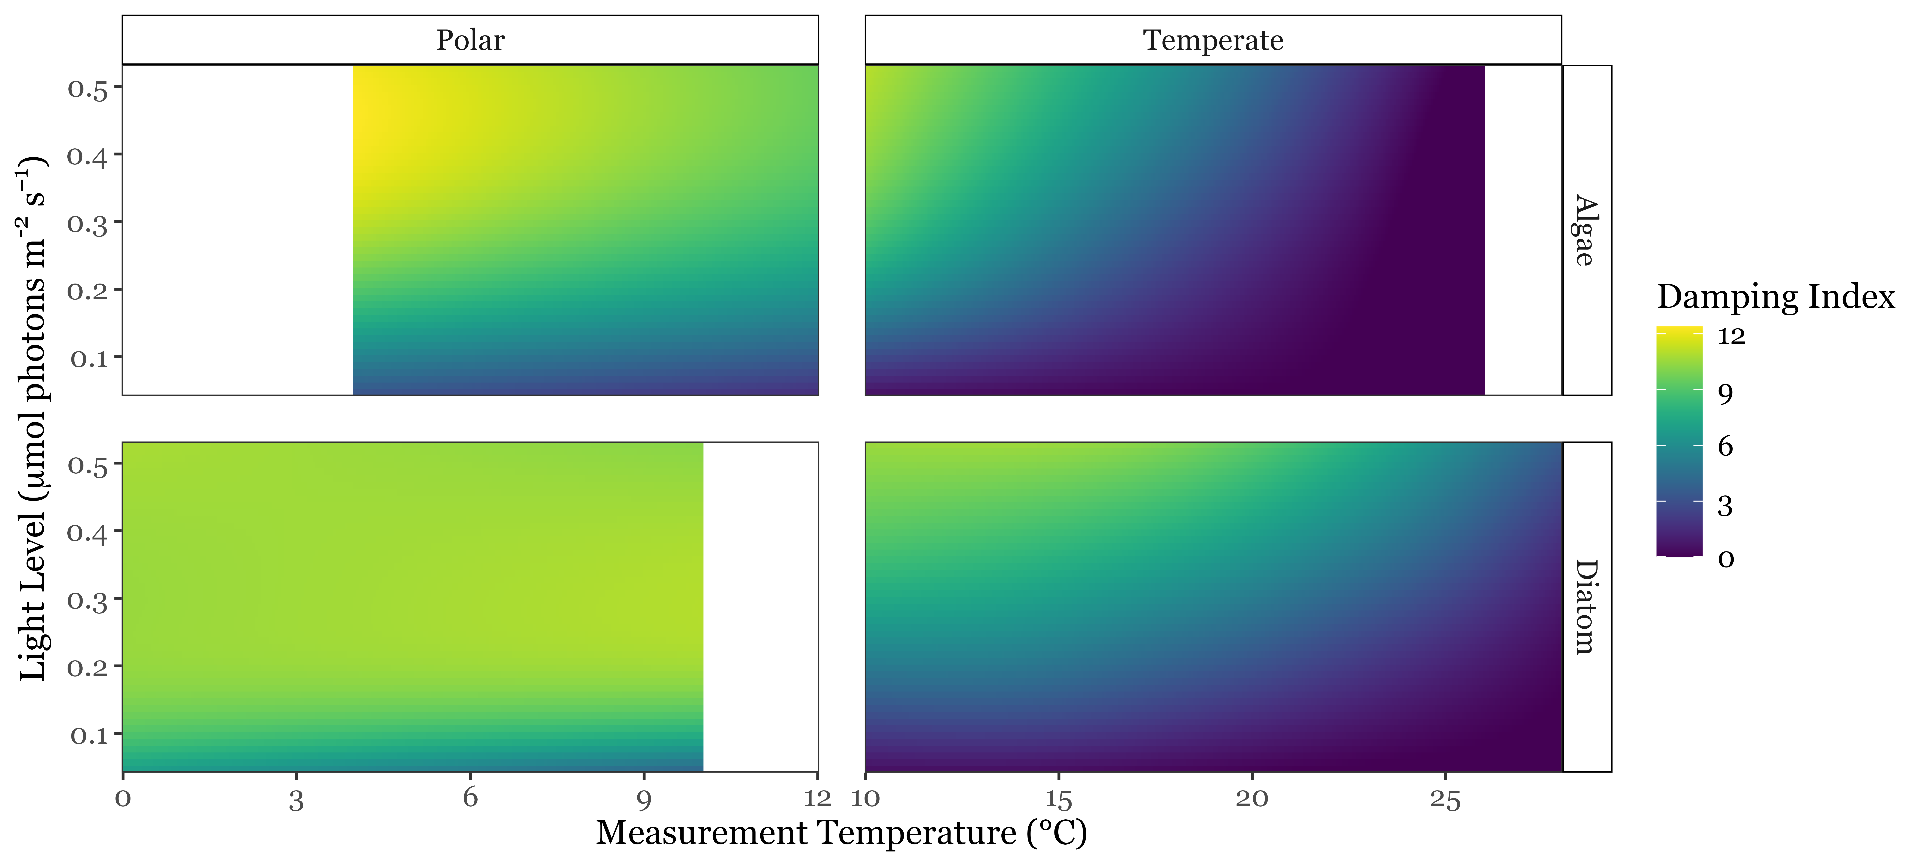
Trends Within Taxa
Individual strains sustain longer cycling under higher steady-state light & lower temperatures

Slide 16
Comparison Across Taxa
Polar strains exhibited significant cycling across a broader range of conditions

Slide 17
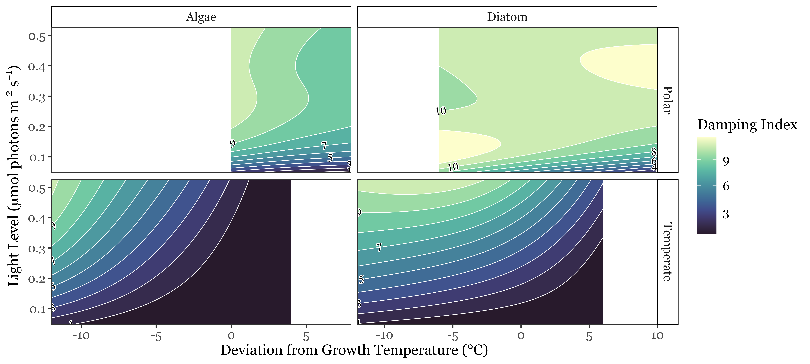
Comparison Across Taxa
Polar strains sustained longer cycling under comparable conditions

Slide 18
Key Conclusions
1
Within taxa, higher light levels and colder temperatures result in stronger maintenance of s-state cycling
2
Polar taxa exhibit significant cycling across a broader range of conditions than their temperate counterparts
3
Polar taxa maintain synchronicity in S-state cycling longer than temperate taxa under comparable conditions
Together, these findings indicate that diverse polar phytoplankton have a unique capacity to sustain photosynthesis under photic stress

Slide 19
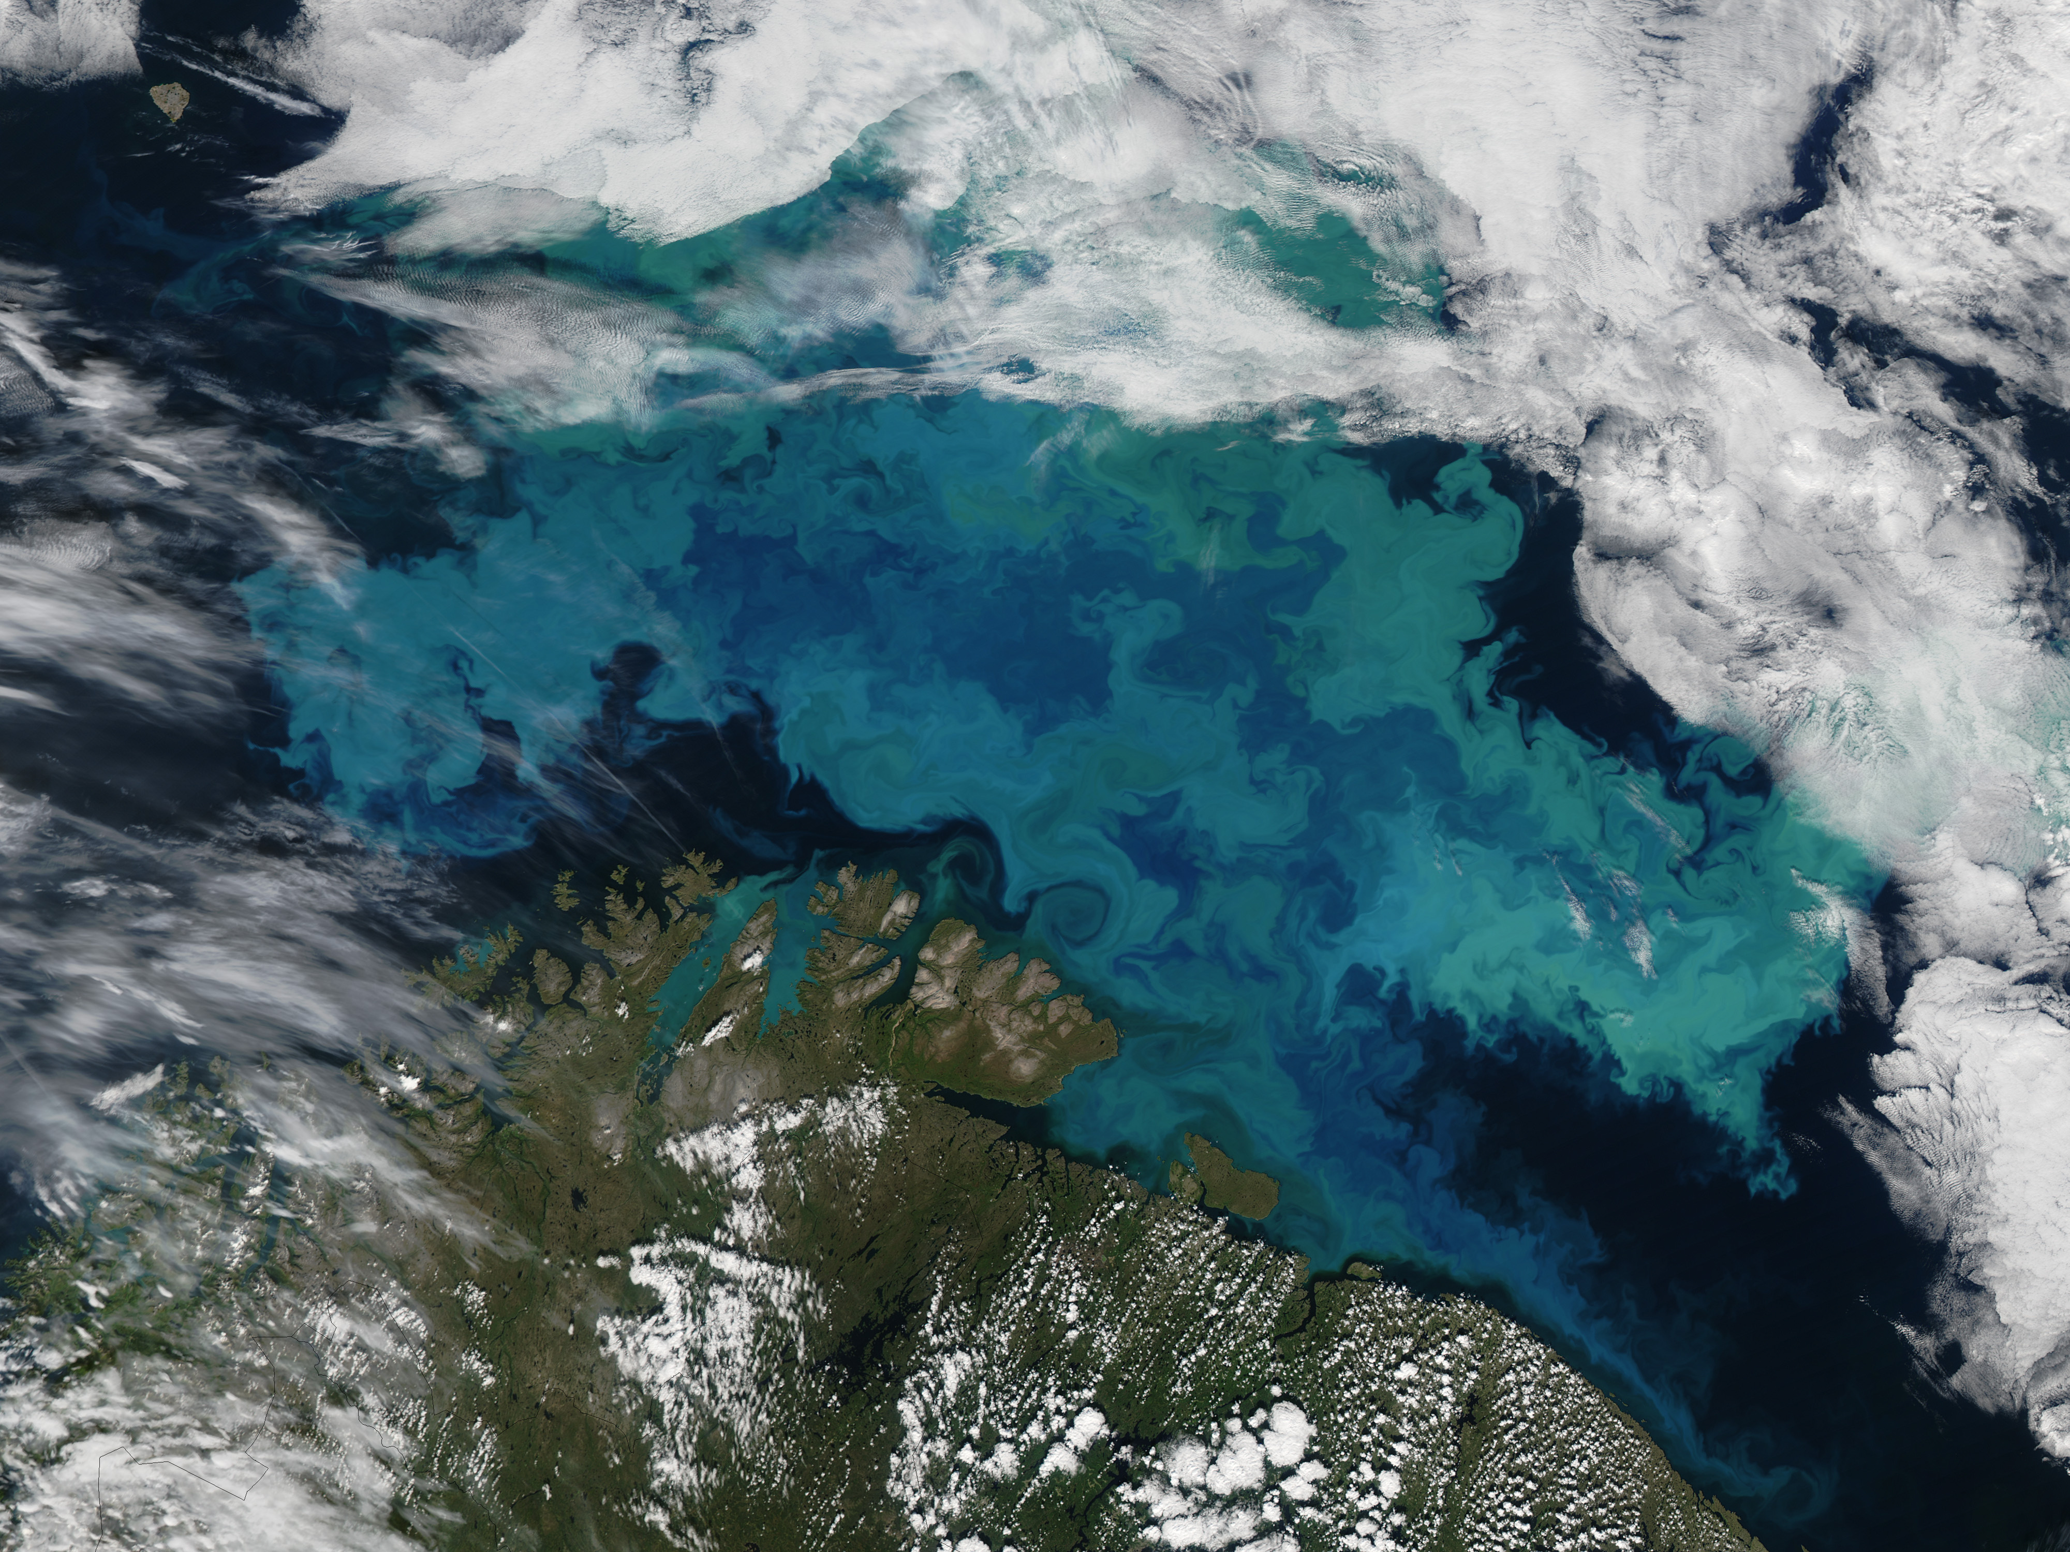





Acknowledgements
I would like to express my gratitude to my supervisor:
Dr. Douglas A Campbell
as well as Campbell Lab members:
Dr. Maximilian Berthold, Naaman Omar, Mireille Savoie, & Sylwia Sliwinska-Wilczewska
and our partners at
The International Research Laboratory Takuvik at Université de Laval
& Cvetkovska Lab at the University of Ottawa

Slide 20
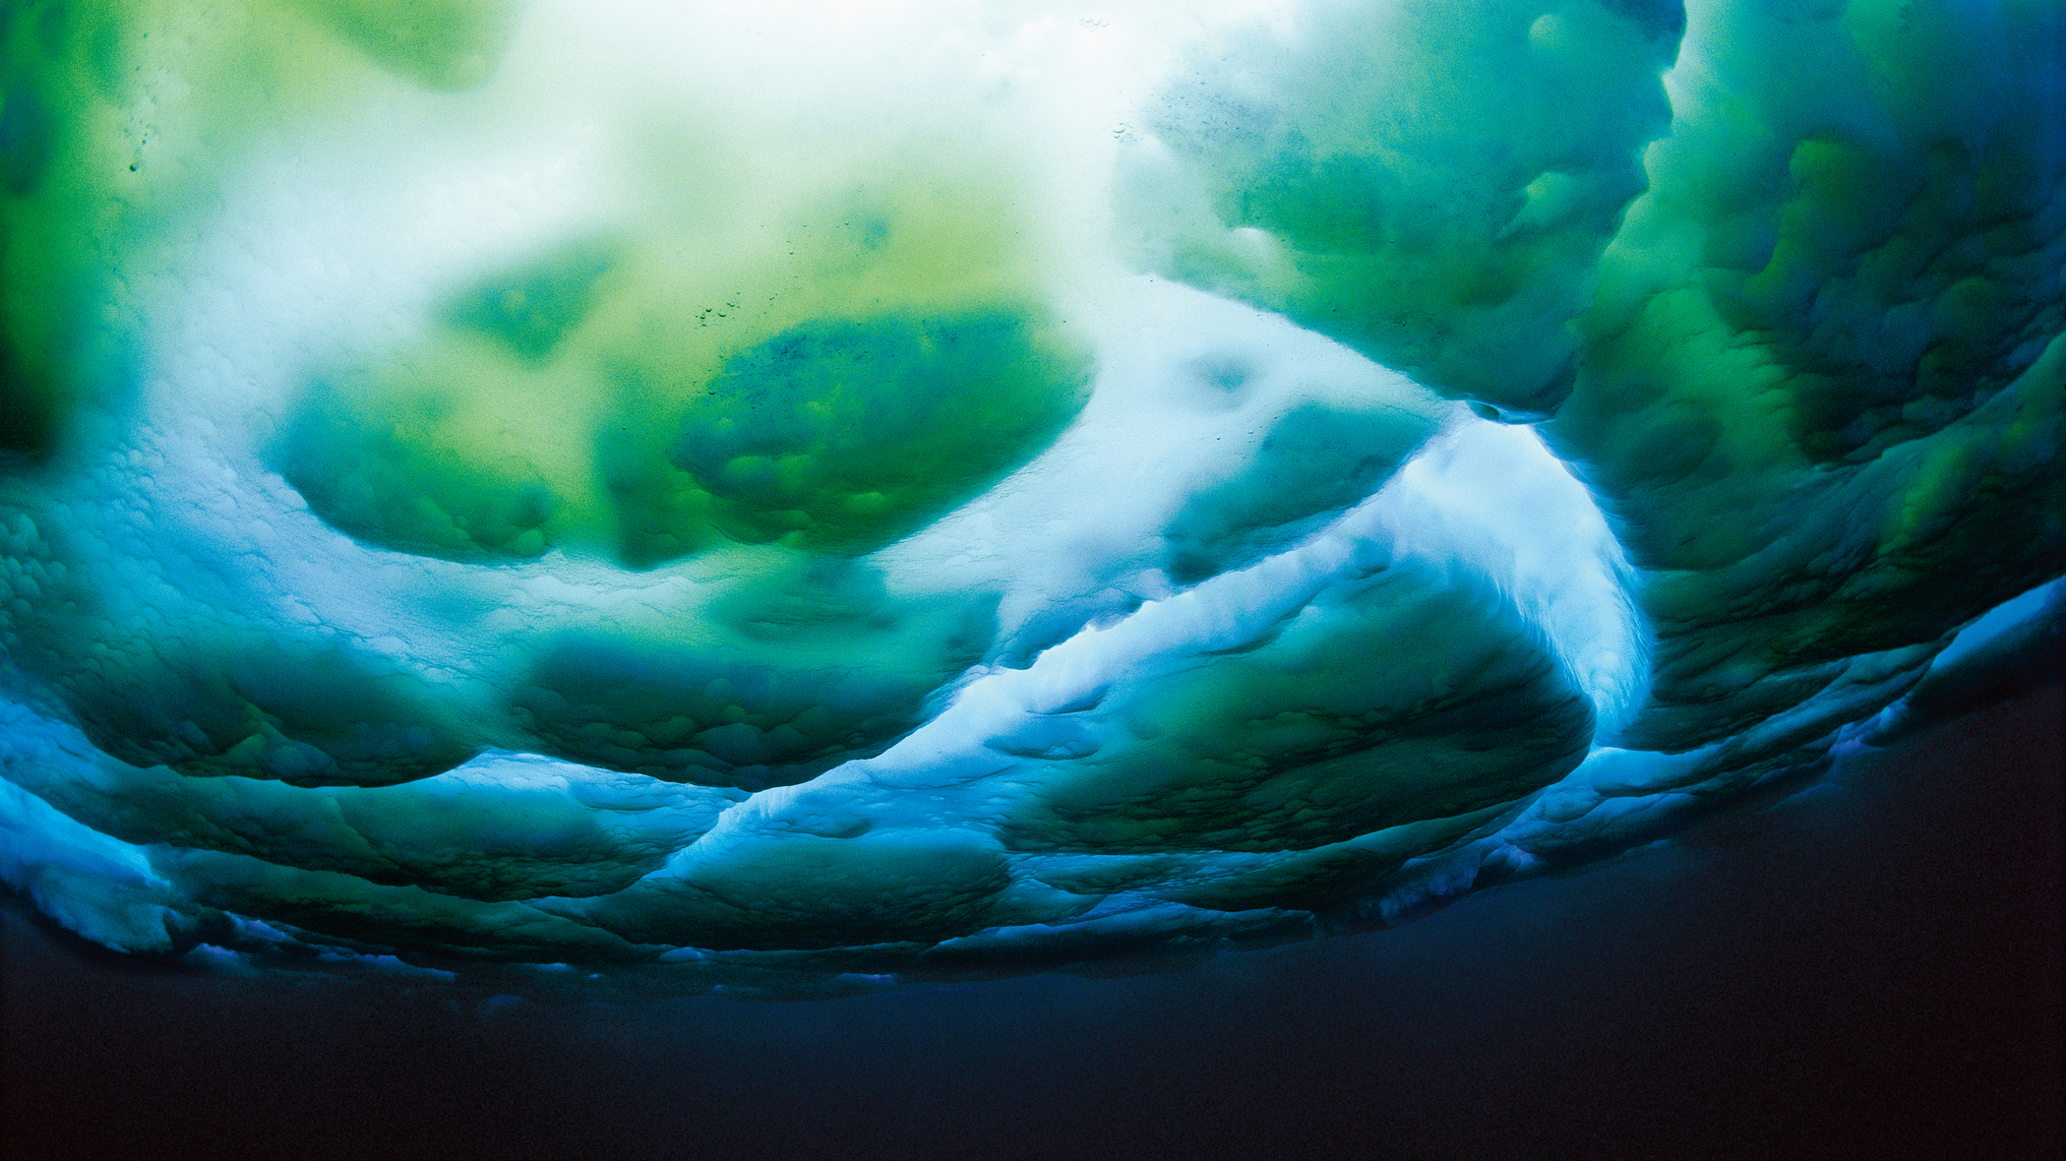
Questions?
Sub-ice algae. Image: M. Stenzel

Slide 21
References

